Slide 1
Modern Control Theory
Model Predict Control - MPC – Lecture 6
Dynamic Prediction Models

Slide 2
Prediction model - Recap

Slide 3
Recap 1: Free response and forced response
Free response –
Check if the system with current input can reach to the set-point or
Find out how close it can take it to the set-point or objective
Forced response –
Don’t make any control action if the system can reach to the set-point or
Compute control actions that can take it to the set-point or objective over and above the free response.

Slide 4
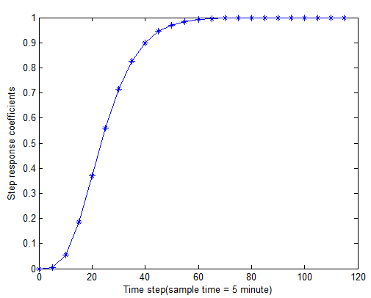
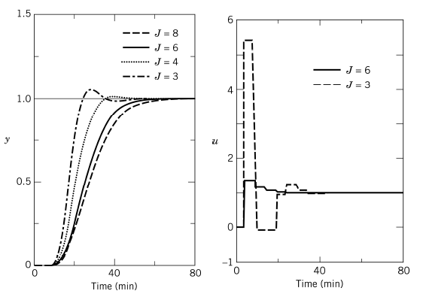
Recap 2: Minimal look ahead or prediction required
J = 3, 4, 6, 8
Δt = 5 mins
As J increases Sj increases
The move required tend to be smaller as J increases
As J decreases, y becomes aggressive

Slide 5
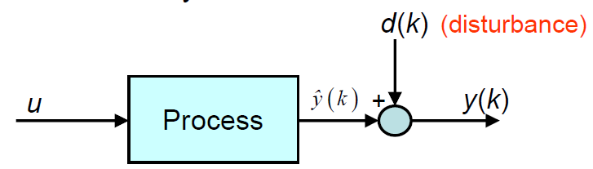

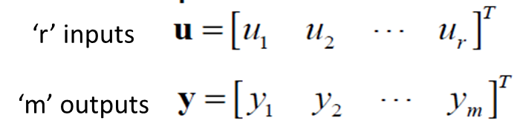

Recap 3: Correcting for model prediction errors
When can predictions drift away actual?
Inaccurate model
Unmeasured disturbances
How do we correct the model predictions?
Output feedback based on the latest measurement
MIMO Model prediction with bias correction
Bias term or
correction term or
Estimated disturbance
is matrix of ‘1’ with dimension mP xm

Slide 6
Dynamic prediction models
Model types
Physics based or data-based (or empirical) models
Linear or non-linear relationships
Types of Linear models
Impulse response coefficients
Step response coefficients – Most process industry implementations
Transfer function
State-space – Recent applications such autonomous vehicles, robots, satellite systems, etc

Slide 7
State space models - Motivation
5 CVs * 5 MVs
Each model has 30 coefficients
Total - ?
Mixed time scale – what is this?
Unstable system?
Can I represent as step coefficients?
Type of disturbances that can be modeled?

Slide 8


Prediction using State space models (1/6)
State measurements
Output measurements
H = C and we can omit z(k)
(A, B) are controllable
(C, A) are observable

Slide 9





Prediction using state space models (2/6)
.
.
.
x_{N} = Ax_{N-1} + Bu_{N-1}

Slide 10
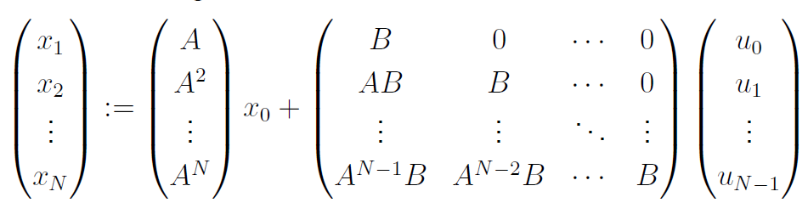
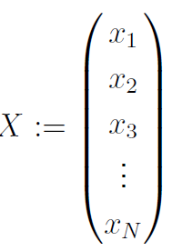
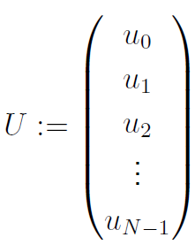
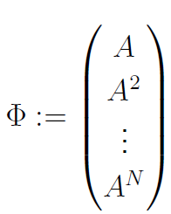
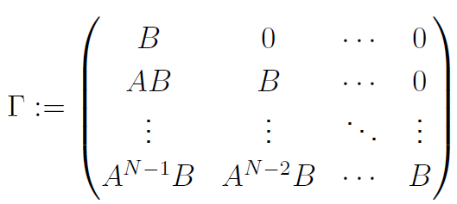
Prediction using State space models (3/6)
Re-arranging the terms in matrix/ vector form
X = Φ x₀ + ΤU
The measurement model y
Free response
Forced response

Slide 11
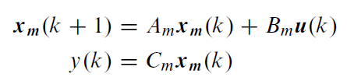




Prediction using State space models (4/6)
X = Φ x₀ + ΤU
Not in incremental of control moves
Free response
Forced response
System
representation
Difference
Define
System in incremental form

Slide 12

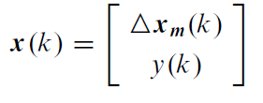
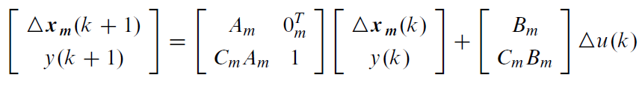

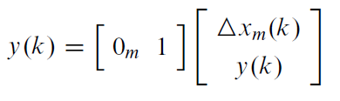
Prediction using State space models (5/6)
System in incremental form
Difference in outputs
Define
We get
y(k) = C x(k)

Slide 13
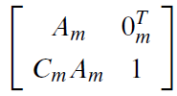
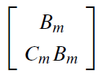

Prediction using State space models (6/6)
System
representation
System in incremental form
y(k) = C x(k)
State Prediction equation
X(k+1) = Φ x₀ + ΤΔU(k)
A =
B =
C =
Y(k) = CΧ(k)
Output Prediction equation

Slide 14


Prediction equation comparison
State space prediction equation
X(k+1) = Φ x₀ + ΤΔU(k)
Y(k+1) = CΧ(k+1)
State space Output Prediction equation
Step response Prediction equation
Free response =
C Φ x₀ =
Forced response =
CΤΔU(k) =

